Slide 1
WakeWell: Circadian Rhythm-Driven Alertness Investigation for optimal Wakefulness
Presented By: Anshu Tripathi
Notes:
Good Afternoon everyone, My name is Anshu Tripathi. I'm here to propose my project
WakeWell: Circadian Rhythm-Driven Alertness Investigation for optimal Wakefulness

Slide 2
Table of Contents
1
Problem Definition and
Importance
Literature Review
2
3
Data Overview
Methodology
4
Evaluation and Observation
5
Success Measure
6
Notes:
I will give a problem definition and importance behind this research, then will talk about literature review, data overview, methodology will move towards all analysis performed with insightful observations, and success measure.
In my presentation today, I will be covering the following topics –

Slide 3
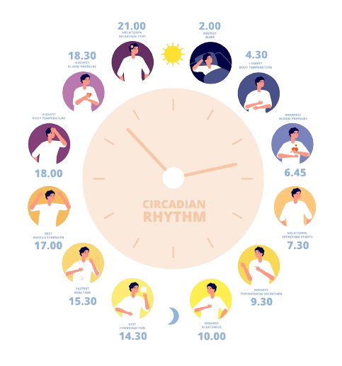
1
Problem
1
6
Various lifestyle factors, including sleep patterns, diet, and physical activity, interact with circadian rhythms to affect morning alertness.
Disruptions to this internal clock can lead to poor sleep, reduced alertness, and productivity.
Poor alertness can lead to accidents, decreased work performance, and long-term health issues.
2
5
3
4
2
Importance
Lifestyles misalign with natural circadian rhythms due to poor diet, sleep schedules, and shift work.
Morning alertness is crucial for human cognitive function, safety, and productivity.
Work related productivity loss costs around 2% of the gross domestic product (GDP) annually, resulting in around $411 billion in the United States alone.

Slide 4
The effect of nutrition and physical activity on sleep quality among adults: a scoping review¹
1
Paper
1
Problem
Examines the interrelationship between nutrition, physical activity, and sleep quality among adults.
Highlights the increasing prevalence of sleep disorders and their detrimental effects on health and well-being.
2
Methodology
Selected 61 articles from databases such as PubMed, ScienceDirect, and Google Scholar.
Included diverse study designs: cross-sectional studies, randomized controlled trials, and experimental studies.
3
Key Findings
Physical Activity: Regular exercise significantly improves sleep quality and reduces sleep disorders.
Nutrition: Carbohydrate-rich diets enhance sleep quality, while high-fat diets are linked to disturbances.
Micronutrients like magnesium and melatonin positively influence sleep.
Caffeine and alcohol consumption are major disruptors of sleep.
Sleep Disorders: Insomnia is the most common issue linked to poor diet and inactivity, with serious health consequences like diabetes and cardiovascular disease.
¹Alruwaili, N. W., Alqahtani, N., Alanazi, M. H., Alanazi, B. S., Aljrbua, M. S., & Gatar, O. M. (2023). The effect of nutrition and physical activity on sleep quality among adults: A scoping review. Sleep Science and Practice, 7(1), 8. https://doi.org/10.1186/s41606-023-00090-4
Notes:
I have gone through 3 papers that I found very relevant.
1st Paper is ….

Slide 5
Associations between bedtime eating or drinking, sleep duration and wake after sleep onset: findings from the American time use survey²
2
Paper
1
Problem
Examine the relationship between food and drink consumption close to bedtime and two key sleep factors: sleep duration and wakefulness after sleep onset (WASO).
Addresses conflicting advice on eating before sleeping and its impact on sleep quality.
2
Methodology
Utilized American Time Use Survey (ATUS) data from the 2003–2018 and analyzed responses from over 124,000 participants aged 15 and older.
Participants reported activities, including eating and drinking within 24 hours before bedtime over two consecutive days.
Linear logistic regression models stratified by gender are used to analyze the data.
3
Key Findings
Eating/Drinking Before Bed: Eating or drinking within one hour of bedtime was associated with longer sleep duration and an increased likelihood of WASO.
Gender Differences: Women and men who experienced longer sleep duration but had higher odds of waking after sleep onset.
Mealtime and Sleep: Longer gaps between eating and bedtime reduced the chances of short sleep duration and sleep disruptions.
Sleep Quality vs. Length: Eating or drinking close to bedtime improves sleep length but may negatively affect sleep quality
²Iao, S. I., Jansen, E., Shedden, K., O’Brien, L. M., Chervin, R. D., Knutson, K. L., & Dunietz, G. L. (2022). Associations between bedtime eating or drinking, sleep duration and wake after sleep onset: Findings from the american time use survey. British Journal of Nutrition, 127(12), 1888–1897. https://doi.org/10.1017/S0007114521003597

Slide 6
Sleep Quality: A Narrative Review on Nutrition, Stimulants, and Physical Activity as Important Factors³
3
Paper
1
Problem
Addresses the growing issue of sleep disorders and insomnia across age groups.
Addresses conflicting advice on eating before sleeping and its impact on sleep quality.
2
Methodology
Used databases like Medline and Web of Science.
Focused on the roles of nutrition, stimulants, and physical activity in influencing sleep quality.
3
Key Findings
Nutrition and Sleep Quality:
High-fiber and complex carbohydrates, Vitamins like vitamin D and minerals like zinc improve sleep quality.
Stimulants and Sleep Quality:
Caffeine disrupts sleep efficiency; Alcohol disrupts the sleep cycle and Nicotine, and long-term cannabis use impair normal sleep patterns.
Physical Activity and Sleep Quality:
Daytime exercise improves sleep and Intense exercise near bedtime may delay the melatonin peak, interfering with sleep.
³Sejbuk, M., Miro´nczuk-Chodakowska, I., & Witkowska, A. M. (2022). Sleep quality: A narrative review on nutrition, stimulants, and physical activity as important factors. Nutrients, 14(9), 1912. https://doi.org/10.3390/nu14091912

Slide 7

Proposed Research
This study provides more descriptive analysis of sleep quality, physical activity, and dietary habits as critical determinants of morning alertness.
Findings suggest that alertness is predominantly shaped by lifestyle choices rather than genetics.
Provides a predictive and interpretable model for personalized health recommendation.

Slide 8
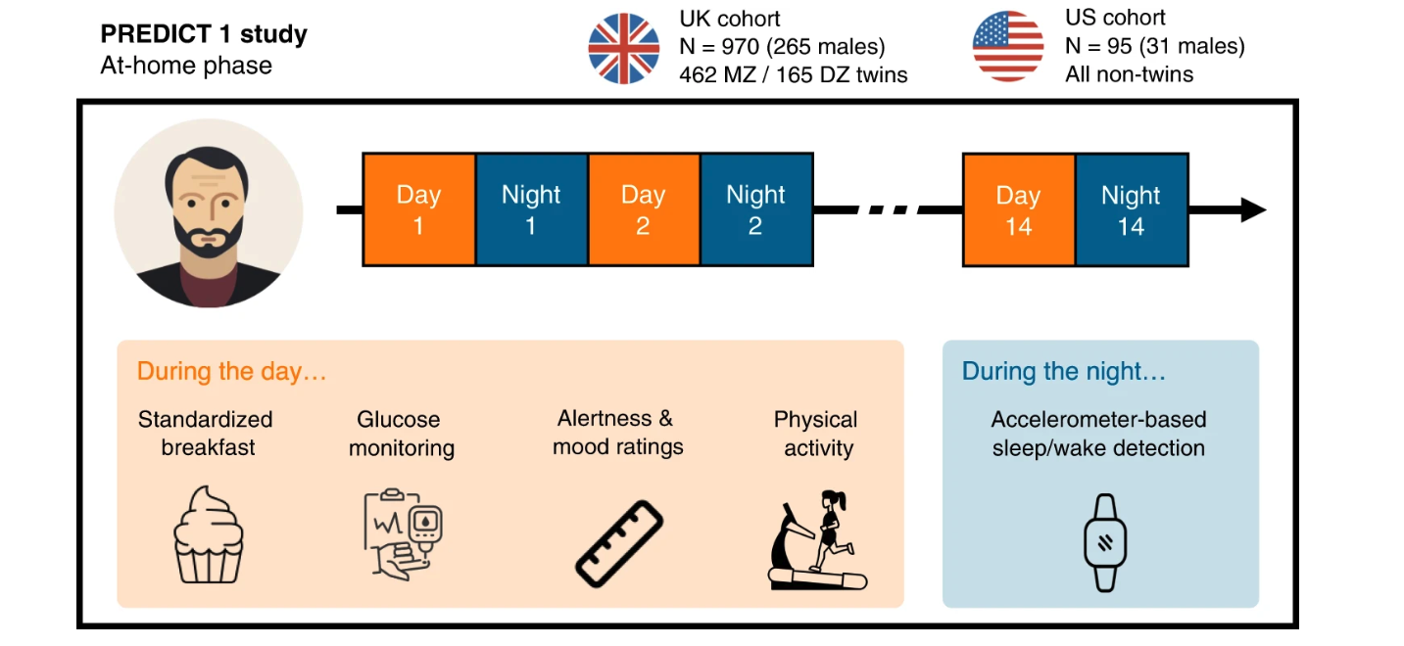
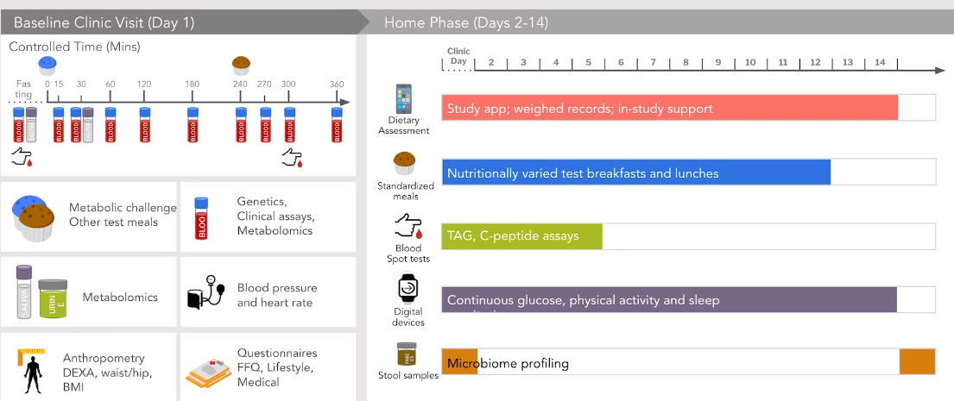
Data Overview
Demographics
No of Participants
Age
BMI
Sex
Race
Zygosity
Country
833 twins
Sleep Parameters
PSQI
Sleep Efficiency
Sleep Period Time
Sleep onset hour
Sleep offset hour
WASO
9542 Sleep parameter samples
Physical Activities and Food
The patient’s (twins) alertness monitored between 2018-2019 has around 89535 samples.
M10 value
L5 value
Meal (breakfast) type
Meal log IAUC (glucose response)
Meal offset to breakfast hour
Data Source
Notes:
Personalized Responses to Dietary Composition Trial (or “PREDICT1”) is a two-country (UK, US) longitudinal study whose primary goal is to predict metabolic responses to foods based on the individual’s characteristics, including molecular biomarkers and lifestyle factors, as well as the nutritional composition of the food. The data is being collected from the user through a mobile app called Zoe App.
PREDICT1 consists of one clinic baseline visit followed by a two-week home-based study. During the at-home phase, participants consumed multiple standardized test meals differing in macronutrient composition, while wearing an accelerometer wristwatch and a continuous glucose monitor.
Demographics
No. participants
Age
BMI
Sex
Race
Zygosity
Country
Sleep Parameters
PSQI - The Pittsburgh Sleep Quality Index (PSQI) is a self-reported questionnaire used to assess the quality of sleep in individuals over the previous month. It provides a single score, ranging from 0 to 21, with higher scores indicating poorer sleep quality.
Sleep Efficiency - Total Sleep Time (TST; = SPT - WASO), (SE, = TST / SPT)
Sleep Period Time - sleep duration (defined as the elapsed time from sleep onset through sleep offset
Sleep onset hour - the time of night when an individual falls asleep, measured in hours relative to midnight.
Sleep Offset hour - the time at which an individual wakes up in the morning or the end of the sleep period
WASO - Wakefulness after sleep onset - the total number of minutes that a person is awake after having initially fallen asleep
Physical Exercise
M10 value (metric of daytime activity) - M10 refers to the median value of the 10 most active hours during the day, calculated via on person sensor, (in mg)
L5 Value - L5 refers to the lower level of activity during the 5 least active hours at night or magnitude of the least active 5-hour period at night. , calculated via on person sensor, (in mg)
Food
Meal (breakfast) types MCB(Metabolic Challenge Breakfast),
OGTT(Oral Glucose Tolerance Test - a diagnostic test to measure how quickly glucose is cleared from the blood after consuming a pure glucose liquid for breakfast.
High Fiber, High Carb, UK Average, High Protein, High Fat
Meal log IAUC (glucose response) - : Incremental Area Under the Curve(IAUC), a measure of blood glucose response to a meal. meal_log_iauc_breakfast" represent the iAUC values for individual participants in the study after they ate breakfast. meal_log_iauc_breakfast" represent the iAUC values for individual participants in the study after they ate breakfast.
Meal offset to breakfast hour - represents the time interval between the time when a participant had their last meal or snack and the time when they had breakfast, measured in hours.

Slide 9
Methodology
Exploratory Data Analysis and Visualization
Data Preprocessing
Data Modeling
Data Interpretability

Slide 10






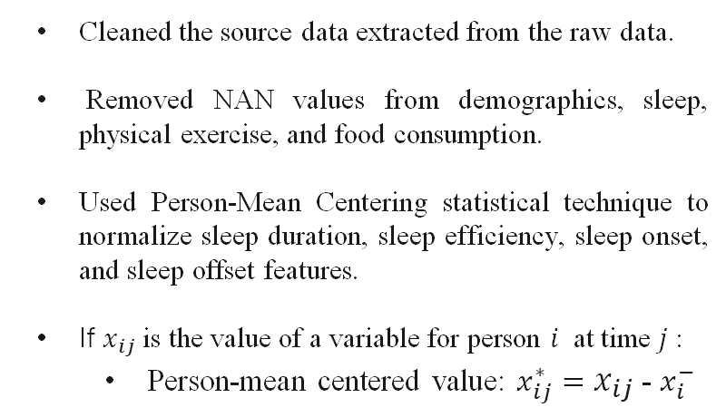
1
2
Exploratory Data Analysis
and Visualization
Data Preprocessing
Cleaned the source data extracted from the raw data.
Removed NAN values from demographics, sleep, physical exercise, and food consumption.
Used Person-Mean Centering statistical technique to normalize sleep duration, sleep efficiency, sleep onset, and sleep offset features.
If $x_{ij}$ is the value of a variable for person $i$ at time $j$:
Person-mean centered value: $x_{ij}^{∗}=x_{ij}$ - $x_{i}^{−}$
Visualized data for each category:
Demographics
Sleep
Physical exercise
Food consumption
Inspected the dataset shape, types, and basic statistics to describe each column data type.

Slide 11



3
4
Data Modeling
Data Interpretability
Prepared the input variables and target variable, where demographics, sleep, physical exercise, and food consumption values are input feature and alertness level is target variable.
Used classical machine learning methods like SVR, XGBRegressor, Ridge, ElasticNet, SGDRegressor, BayesianRidge, LinearRegression, RandomForestRegressor.
Selected the best performed predictive model out of it.
Used interpretability methods to understand model behavior and predictions and provided insights into the importance of features
Ranked the alertness level high and low contributing features, enhancing the model’s transparency and interpretability.

Slide 12
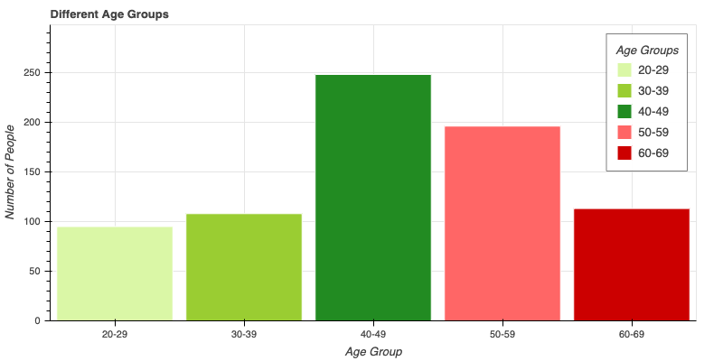
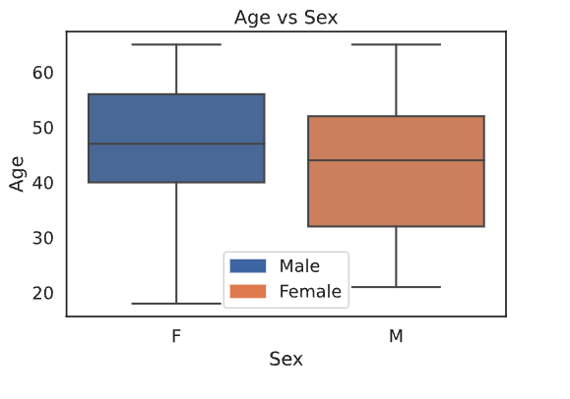
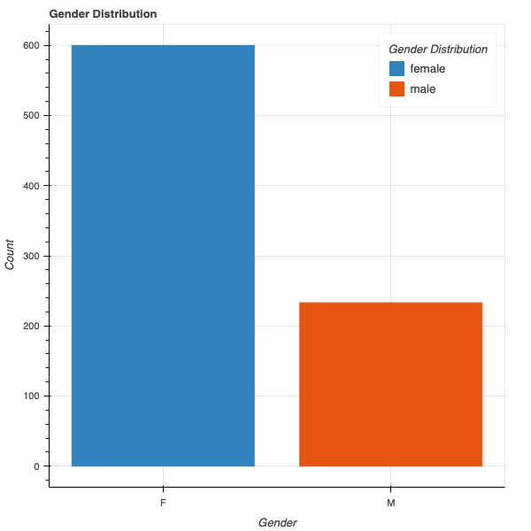
Data Analysis - Demographics
The 40–49 age group is the largest, while the 20–29 group is the smallest in the dataset.
Females have a higher count than males.
The median age for females is slightly higher, with a wider age range compared to males.
Notes:
Let’s move to the analysis for Demographics. The participants are from age group 16-65. Female ratio is more than male, also more female old people are there than the males. Also, we plotted the number of people for a particular BMI and age group.

Slide 13

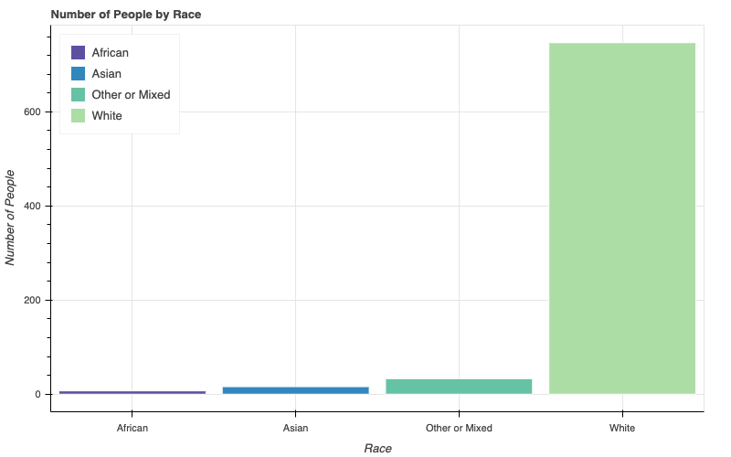
Data Analysis - Demographics
The data consists of mix of Monozygotic, Dizygotic and not twins.
Monozygotic (one eg splits and develops into two babies with exactly the same genetic information).
Dizygotic (two eggs are fertilized by two sperm and produce two genetically unique children )
Notes:
Let’s move to the analysis for Demographics. The participants are from age group 16-65. Female ratio is more than male, also more female old people are there than the males. Also, we plotted the number of people for a particular BMI and age group.

Slide 14
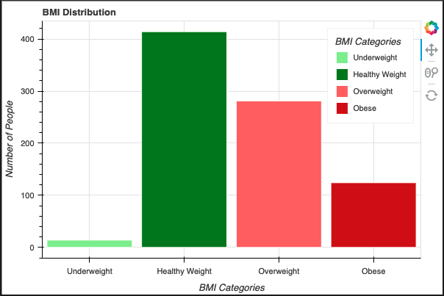
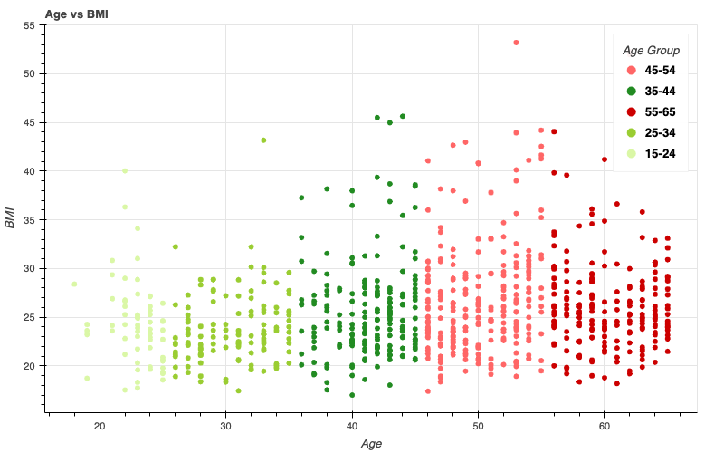
Data Analysis - Demographics
BMI below 18.5 is underweight, 18.5 - 24.9 is normal weight, 25 – 29.9 is overweight, and 30+ is obesity.
Highest number of healthy weight people

Slide 15
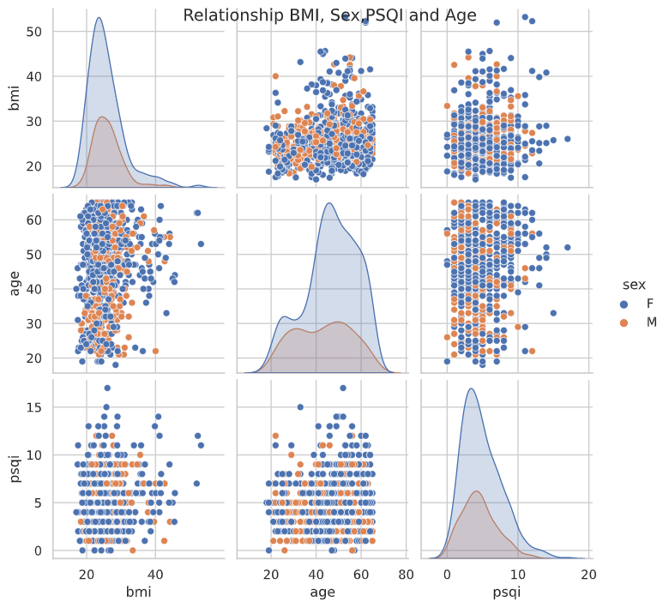
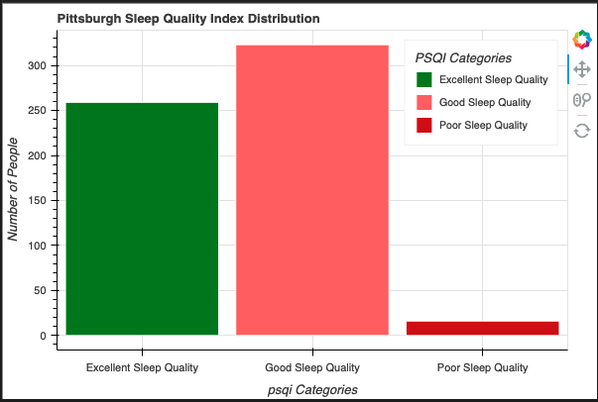
Data Analysis - Demographics
PSQI ranges from 0-4 is excellent sleep quality, 5-11 is good sleep quality, and 12-21 is poor sleep quality.
Notes:
The pair plot shows the relationship between BMI, age, and PSQI scores, with the data separated by sex
Pittsburgh Sleep Quality Index - a questionnaire-based tool to assess sleep quality ranges between 0-21. Higher score indicating poor sleep quality.
0-3.9 excellent sleep quality, 4-10.9 good sleep quality, 11-21 poor

Slide 16
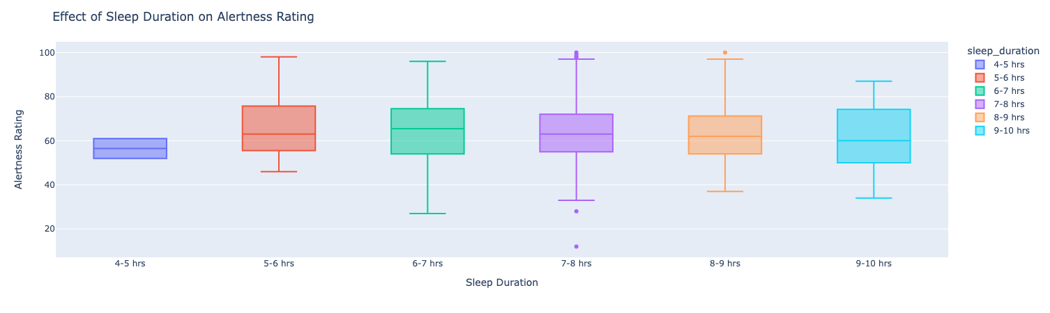
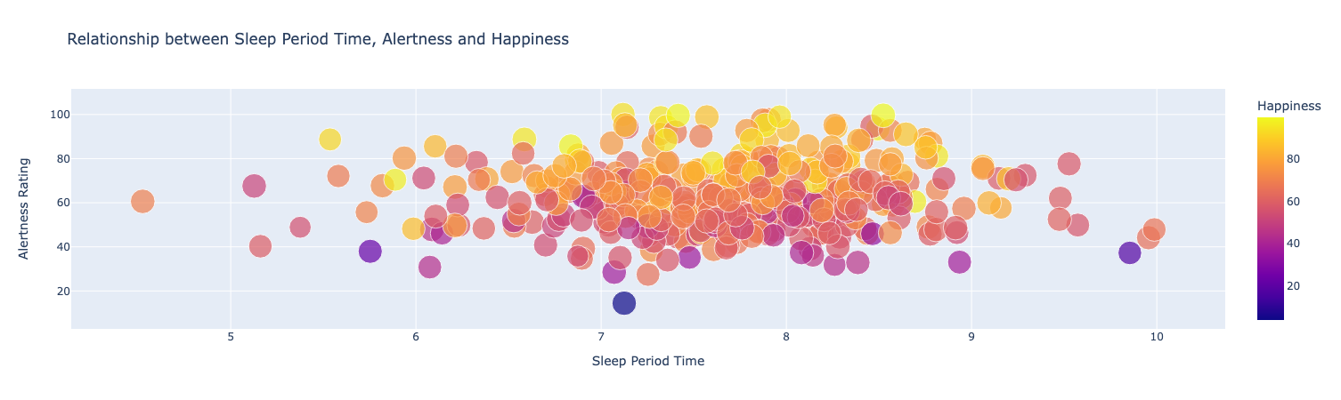
Data Analysis - Sleep
Alertness is highest for the happy people with the sleep period time of 7 – 9 hours.
Notes:
In the first plot we would assume that a person sleeping more would have better alertness than a person who sleeps less. But it depends on a lot of factors such as Sleep efficiency and sleep onset and offset
Sleep onset refers to the time of night when an individual falls asleep
Sleep offset refers to the time at which an individual wakes up.
Happiness is also related to alertness we can see for the same SE and sleep period time, the higher the happiness and mental wellbeing the more the alertness of a person will be.

Slide 17
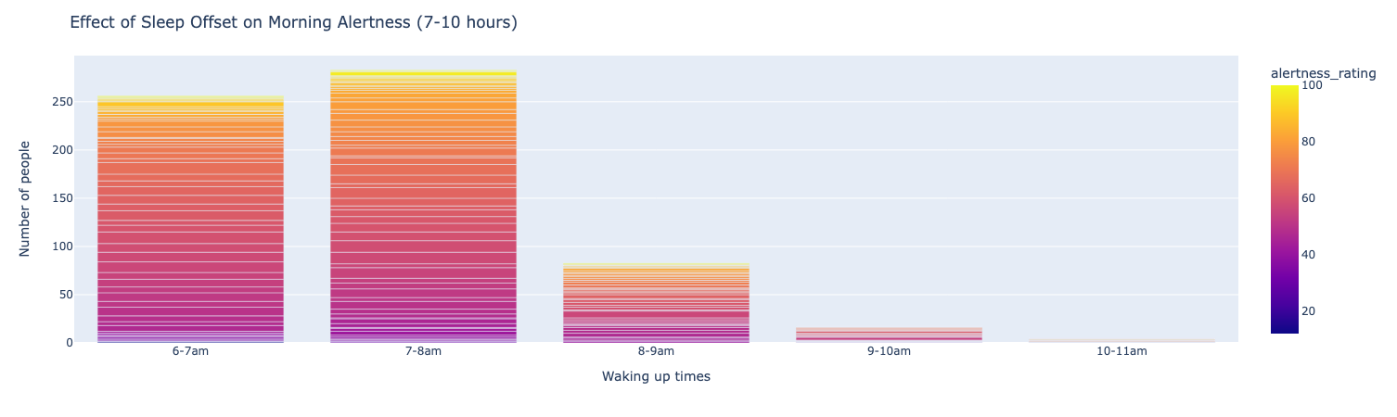
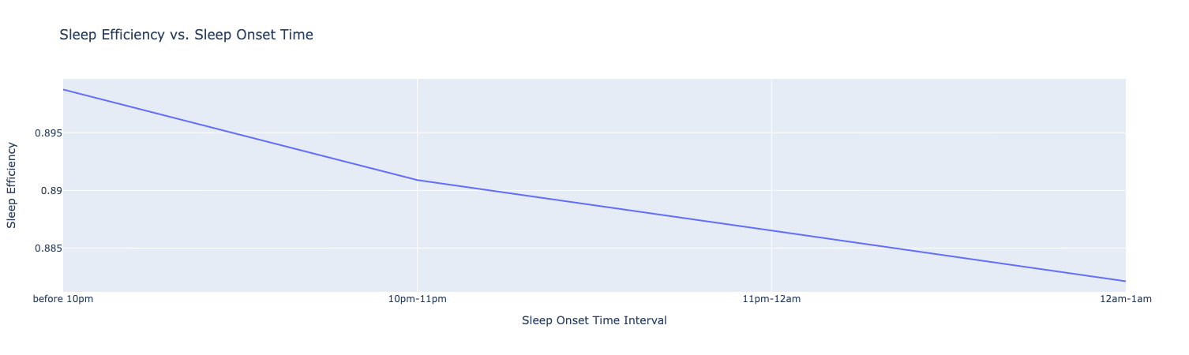
Observation: Sleep I
Individuals who wake up early exhibit higher levels of alertness compared to those who wake up late, even with the same amount of good sleep.
Sleep efficiency states that the later an individual sleeps, the lower their sleep efficiency, resulting in reduced alertness despite getting the same amount of sleep as an early riser.
This aligns with the hypothesis of circadian rhythm, that our body follows a natural biological clock, and functions optimally during specific times.
Notes:
We considered individuals who sleep for a recommended duration of 7-10 hours in this analysis.
Our findings suggest that individuals who wake up early exhibit higher levels of alertness compared to those who wake up late, even with the same amount of good sleep.
This can be attributed to the concept of sleep efficiency, which states that the later an individual sleeps, the lower their sleep efficiency, resulting in reduced alertness despite getting the same amount of sleep as an early riser.
This aligns with the hypothesis of circadian rhythm, which proposes that our body follows a natural biological clock, and functions optimally during specific times.

Slide 18
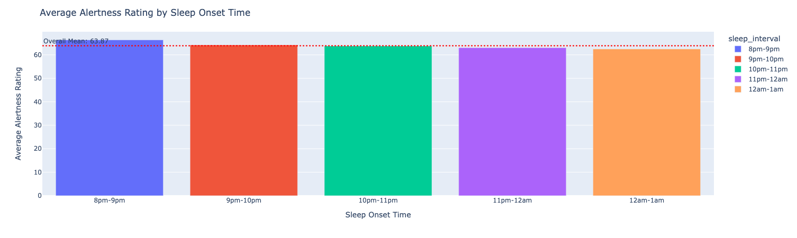
Observation: Sleep II
Building on my hypothesis, I observed that as the sleep onset time for individuals moves further from their natural circadian rhythm, their alertness rating decreases.
Individuals who do not align their sleep patterns with their biological clock experience reduced alertness compared to those who do.
This is one reason why productivity tends to be lower during late-night hours than in the morning.

Slide 19
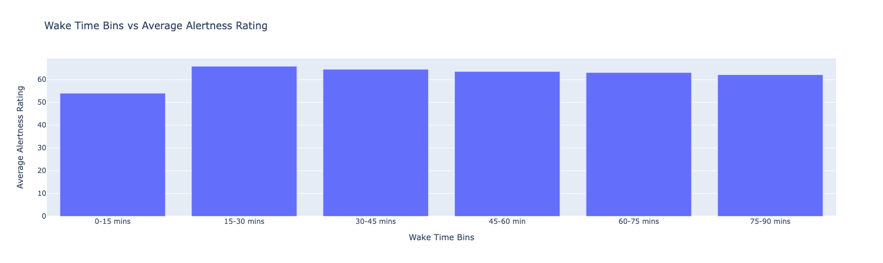
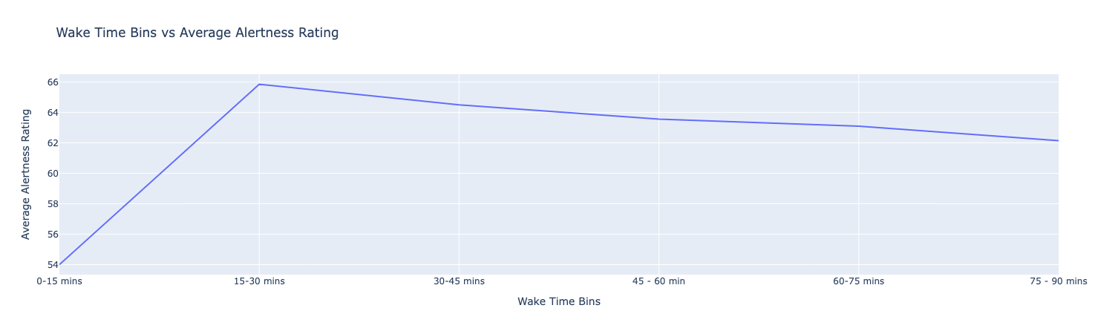
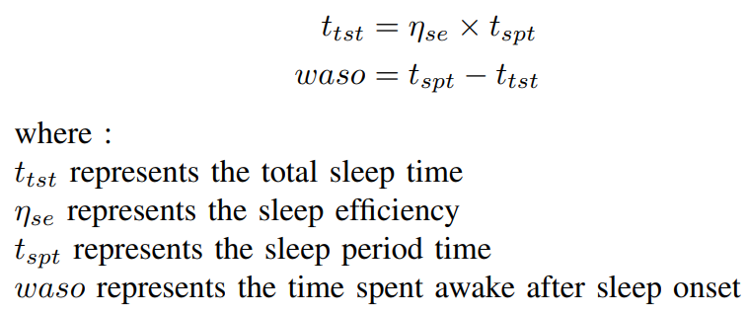
Observation: Sleep III
Wakefulness after Sleep Onset (WASO) related to reduced alertness.
Individuals who experience more awakenings after initially falling asleep will have reduced alertness the following day.
Alertness decreases as the amount of time spent in wakefulness after sleep onset increases.

Slide 20
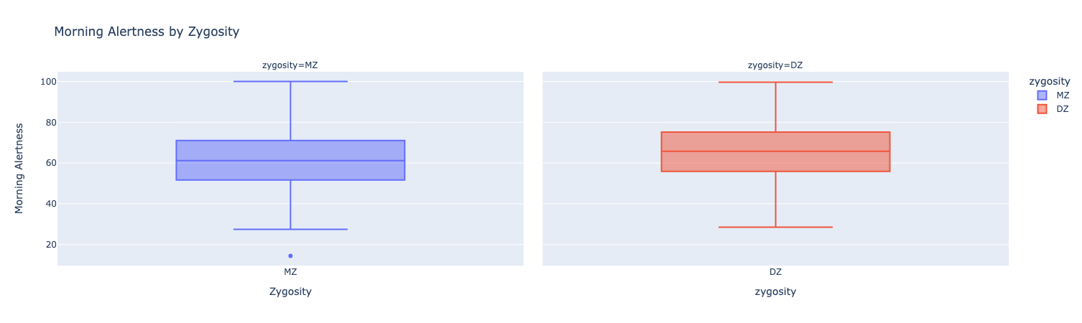
Observation Sleep IV
Alertness as compared between different zygosities: Monozygotic (MZ) and Dizygotic (DZ).
Alertness is quite close to each other, thus the type of zygosity is not an essential parameter for alertness characterization.
Notes:
In this study we didn’t find any trait between the alertness and genetics. We can see a little bit DZ people have more high alertness level. But requires other trait analysis to reach any significant point.

Slide 21
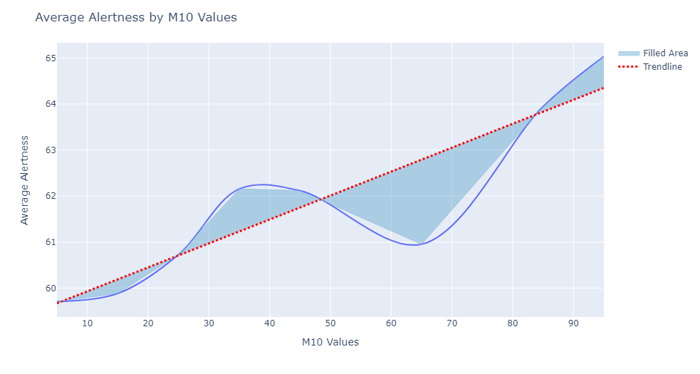
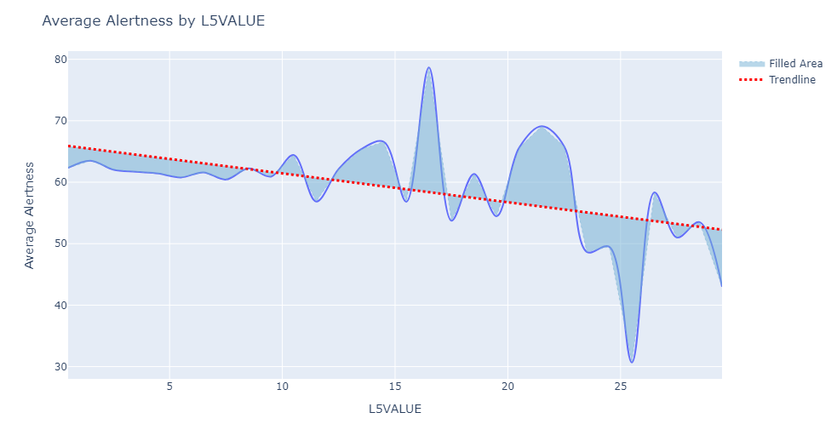
Observation : Physical Exercise
Higher activity during day → High Alertness
Higher activity during night → Low Alertness
M10 value (metric of daytime activity) - M10 refers to the median value of the 10 most active hours during the day.
L5 Value - L5 refers to the lower level of activity during the 5 least active hours at night.
A relationship exists between movement during the least active period and next-day alertness, as evidenced by the L5 value plot. Specifically, higher L5 values are associated with lower alertness ratings.
Notes:
Greater movement -> lower alertness (L5 value)
The level of physical activity undertaken on the day prior to sleeping has a significant impact on next-day morning alertness. Our analysis supports this hypothesis, as demonstrated by the M10 values representing the amount and intensity of exercise performed on the previous day.
Additionally, the L5 value represents the intensity and amount of movement during the least active 5 hours of the day, including the sleep period.
This supports the hypothesis that a relationship exists between movement during the least active period and next-day alertness, as evidenced by the L5 value plot. Specifically, higher L5 values are associated with lower alertness ratings.

Slide 22
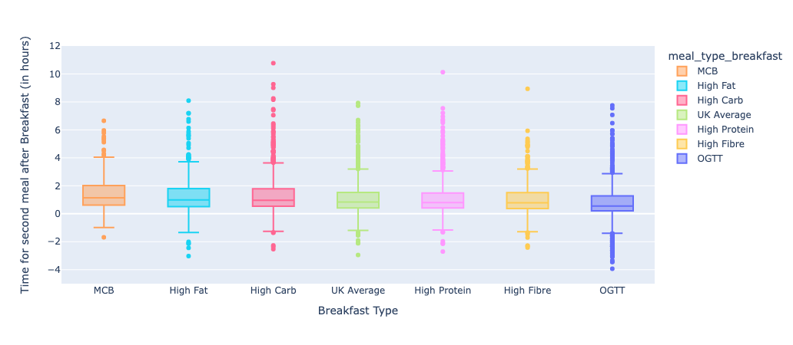
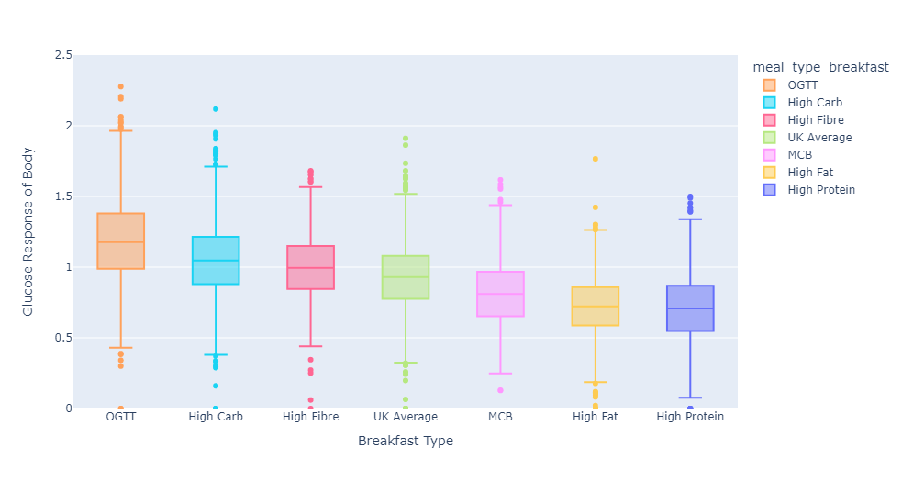
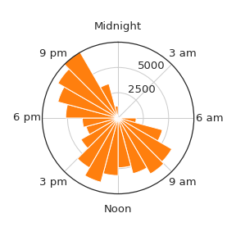
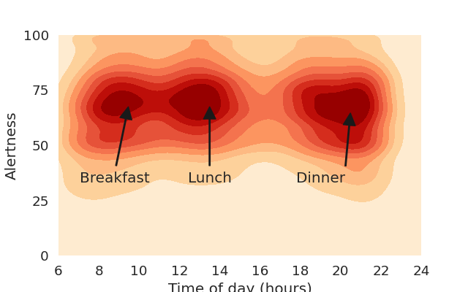
Data Analysis – Food Consumption
MCB has a more balanced macro nutritional content than the rest of the food.
Number of alertness ratings as a function of time of day.
OGTT has the highest glucose response.
Notes:
OGTT has the highest glucose response, we have the urge to eat something very quickly as compared to others
MCB has a more balanced macro nutritional content than the rest of the food
Polar histogram of the number of alertness ratings as a function of time of day

Slide 23
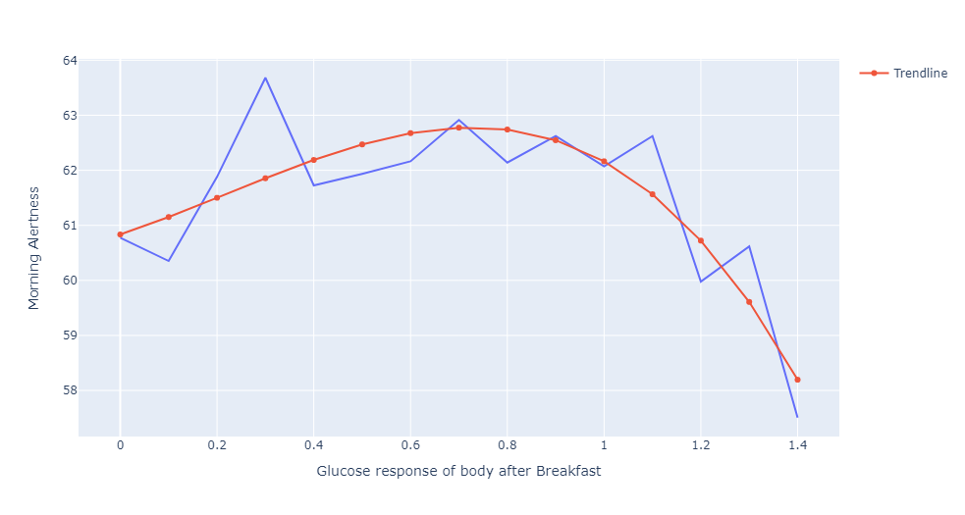
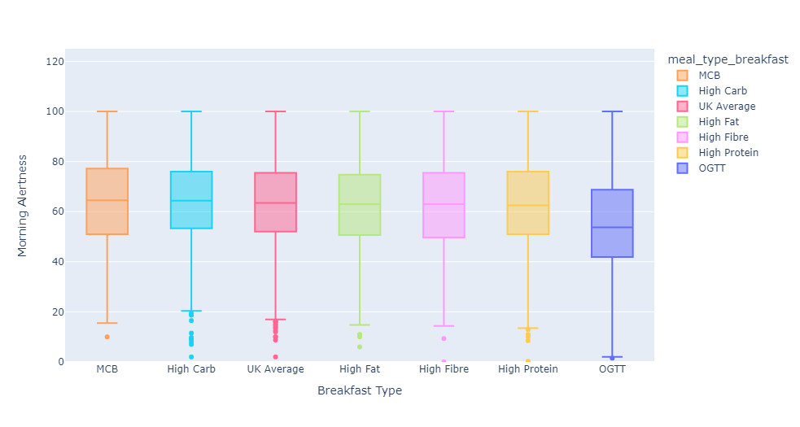
Observation : Food Consumption I
Macronutrients composition with higher carbs → High Alertness
Higher protein breakfast leads to decreased Alertness
IAUC response or energy content has no effect on Alertness
Notes:
The hypothesis suggests that the macronutrient composition of breakfast, specifically the amount of carbohydrates and protein consumed, affects levels of alertness following sleep. The MCB had a higher combination of Carbohydrates and fats than the others.
A higher carbohydrate breakfast is associated with increased alertness, while a higher protein breakfast leads to decreased alertness. Additionally, the consumption of pure glucose in the form of an oral glucose tolerance test (OGTT) is linked to a marked reduction in alertness levels.
The results also support the hypothesis that the effects of breakfast on alertness are not driven by differences in total energy content or postprandial blood glucose levels.
Overall, the hypothesis suggests that the actual macronutrient composition of breakfast, rather than energy content or blood glucose levels, is a key factor influencing subsequent alertness levels.

Slide 24
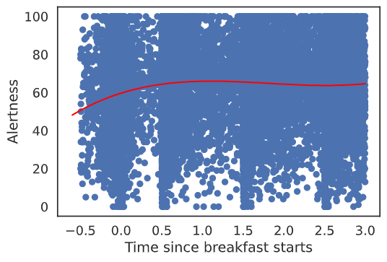
Observation : Food Consumption II
The study revealed a significant increase in morning alertness immediately after breakfast, followed by a sustained plateau of alertness levels for the subsequent 2.5 hours.
Notes:
The study revealed a significant increase in morning alertness immediately after breakfast, followed by a sustained plateau of alertness levels for the subsequent 2.5 hours.

Slide 25
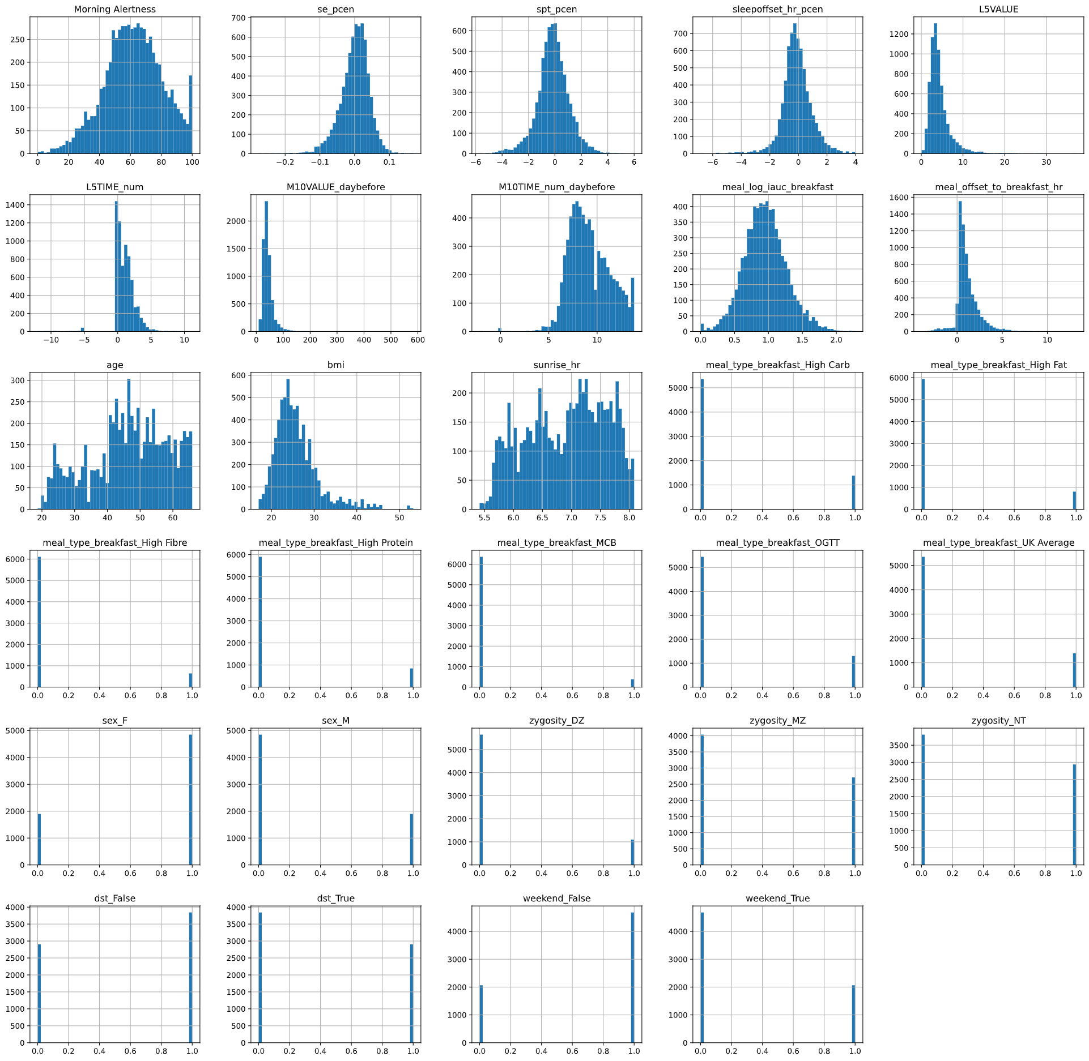
Model Analysis
Dropped the categorical attributes and consider the numerical attributes for skewness reduction
categorical_attributes: ['meal_type_breakfast', 'sex', 'zygosity', 'dst', 'weekend', 'family_id', 'username’]
numerical_attributes: ['Morning Alertness', 'se_pcen', 'spt_pcen', 'sleepoffset_hr_pcen', 'L5VALUE', 'L5TIME_num', 'M10VALUE_daybefore', 'M10TIME_num_daybefore', 'meal_log_iauc_breakfast’, 'meal_offset_to_breakfast_hr', 'age', 'bmi', 'sunrise_hr’
Notes:
Dropped the categorical attributes and consider the numerical attributes for skewness reduction
categorical_attributes: ['meal_type_breakfast', 'sex', 'zygosity', 'dst', 'weekend', 'family_id', 'username’]
numerical_attributes: ['Morning Alertness', 'se_pcen', 'spt_pcen', 'sleepoffset_hr_pcen', 'L5VALUE', 'L5TIME_num', 'M10VALUE_daybefore', 'M10TIME_num_daybefore', 'meal_log_iauc_breakfast', 'meal_offset_to_breakfast_hr', 'age', 'bmi', 'sunrise_hr’

Slide 26
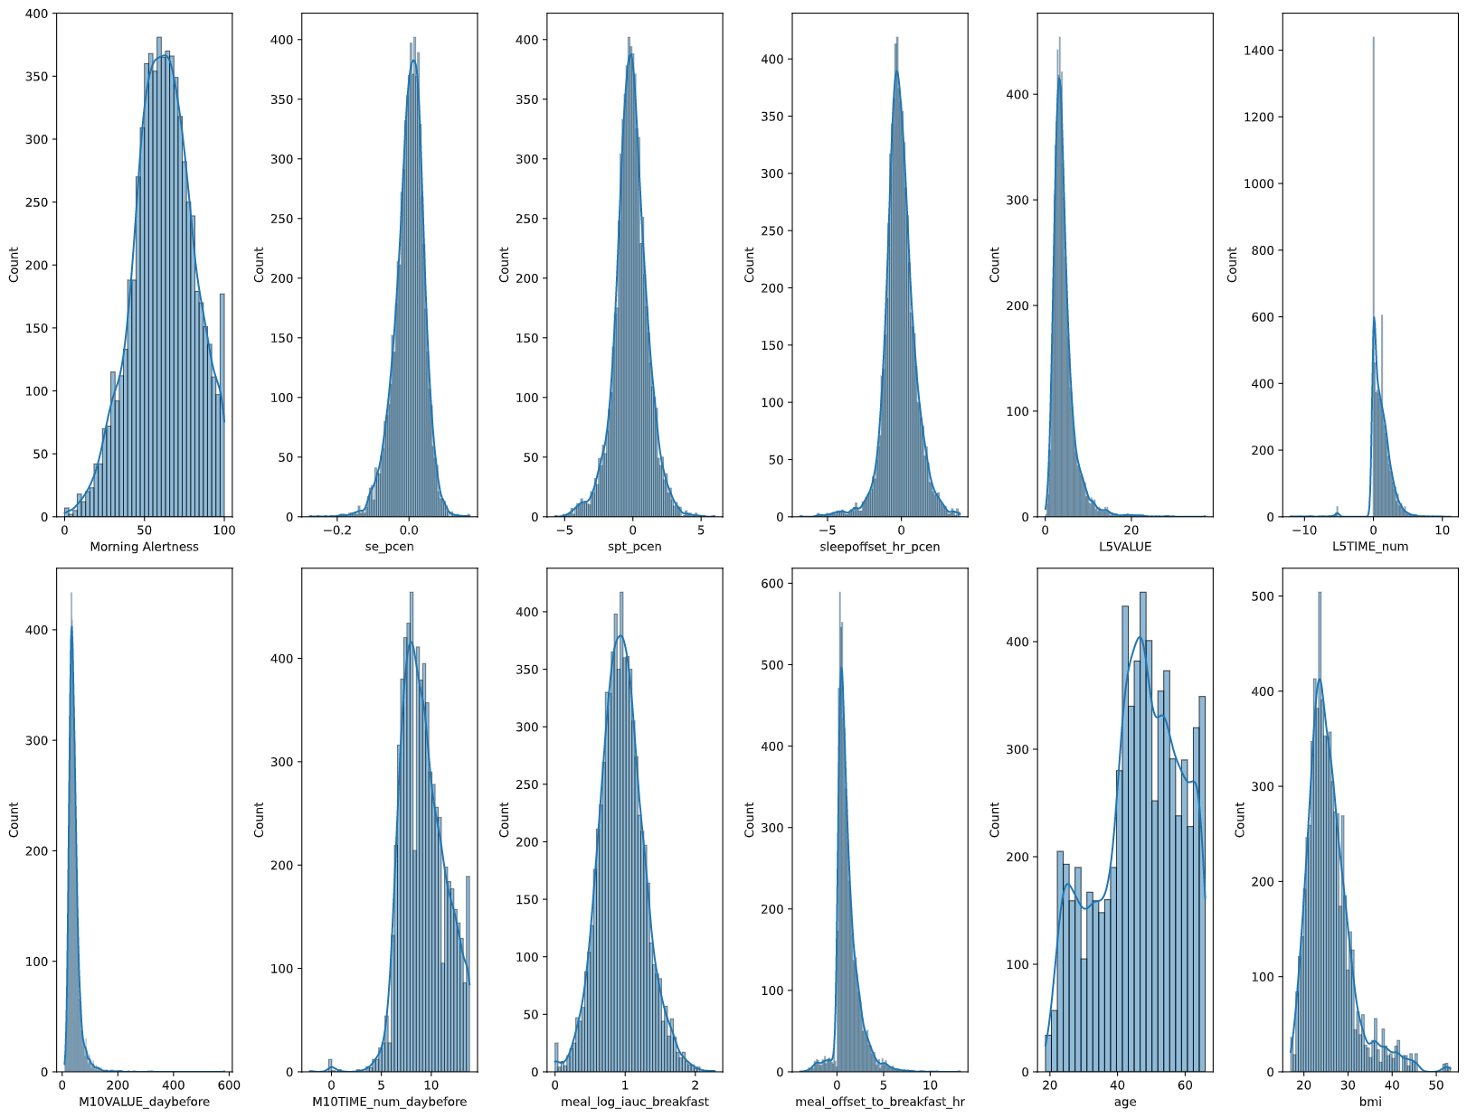
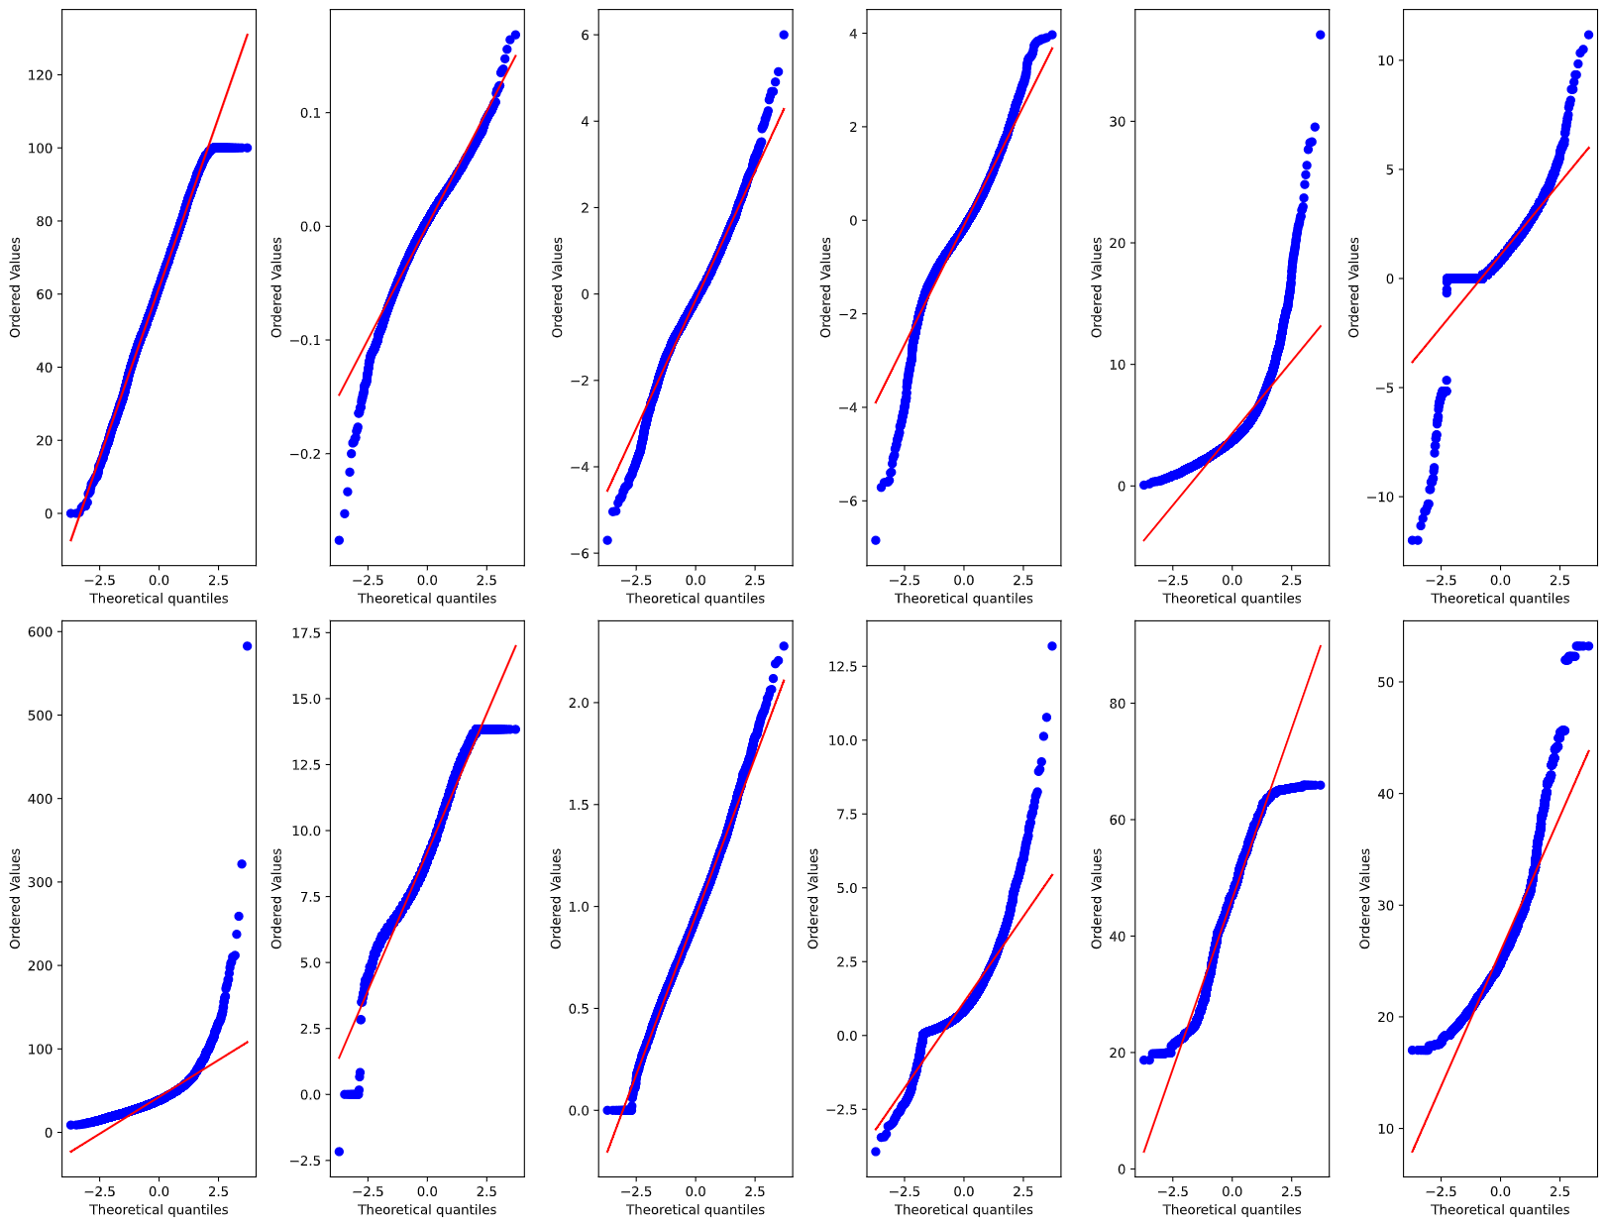
Model Analysis
Notes:
These plots helped us to understand the distribution, which one is more or less normally distributed.

Slide 27
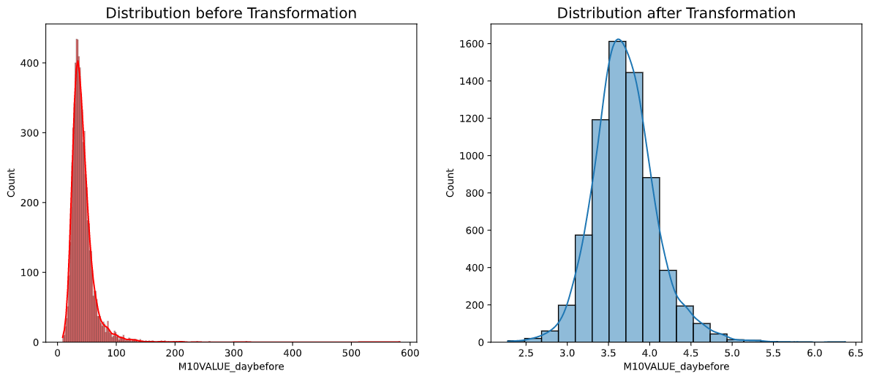
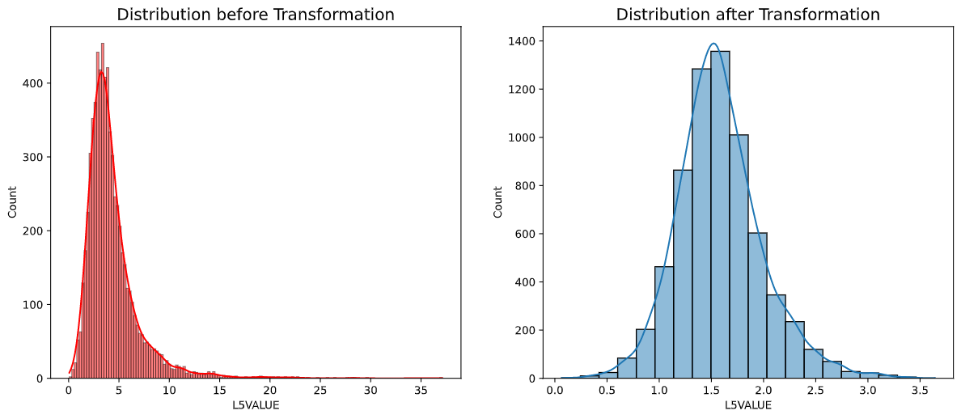
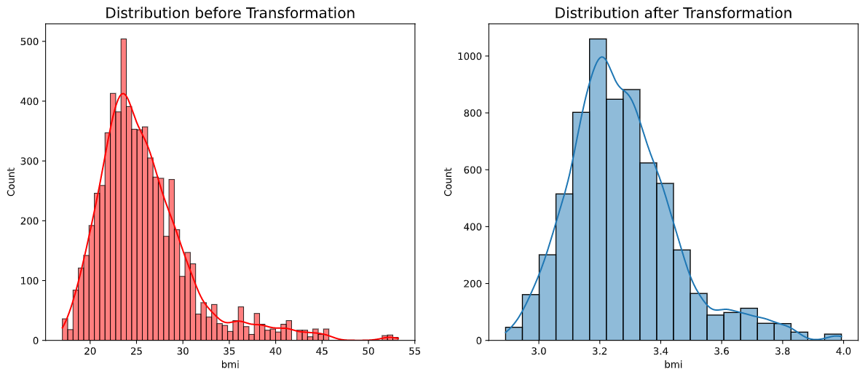
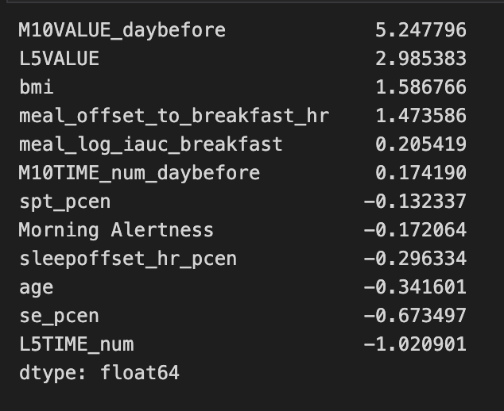
Model Analysis
Skewness before: 5.25 Skewness after: 0.5
Skewness before: 2.99 Skewness after: 0.55
Skewness before: 1.59 Skewness after: 0.87
Notes:
'''Positive value means the distribution is skewed to the right. Negative value means the distribution is skewed to the left. 0 means perfect normal distribution. The bell shaped curve’’’
consider the numerical attributes for skewness reduction
Log transformation → right skewed
Square transformation → left skewed
In this transformation technique, we have used log of each and every value in the feature. So when we use logs of a certain distribution, we will use their exponents instead of the actual value. This makes the X scale exponentially grow in value and that is the reason why only Right Skewed data transforms to a more or less normal distribution, .Only for right skewed data.
In this transformation technique, we will use square of each and every value in the feature. This will only work on Left Skewed data. So, use Square Transform for left skewed data and Log Transform for right skewed data. Simple.

Slide 28
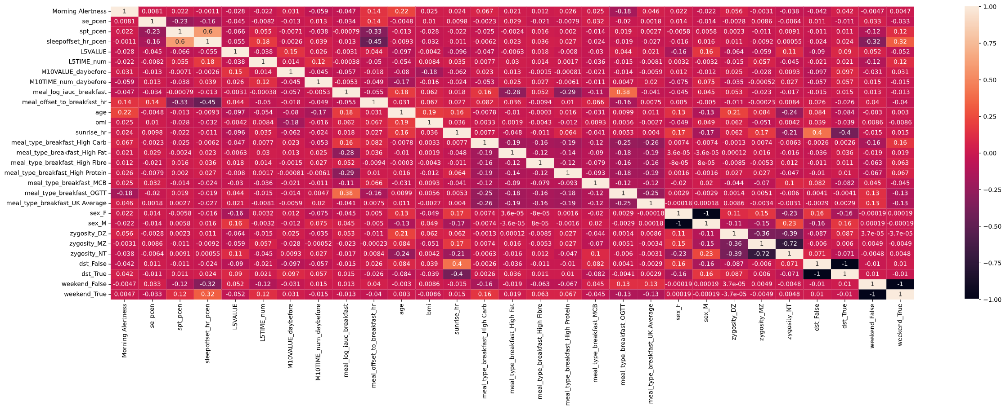
Model Analysis (Success Measure)
Notes:
Sleep onset hr sleep offset hr highly coorrelated so we have just considered sleep offset hr.

Slide 29
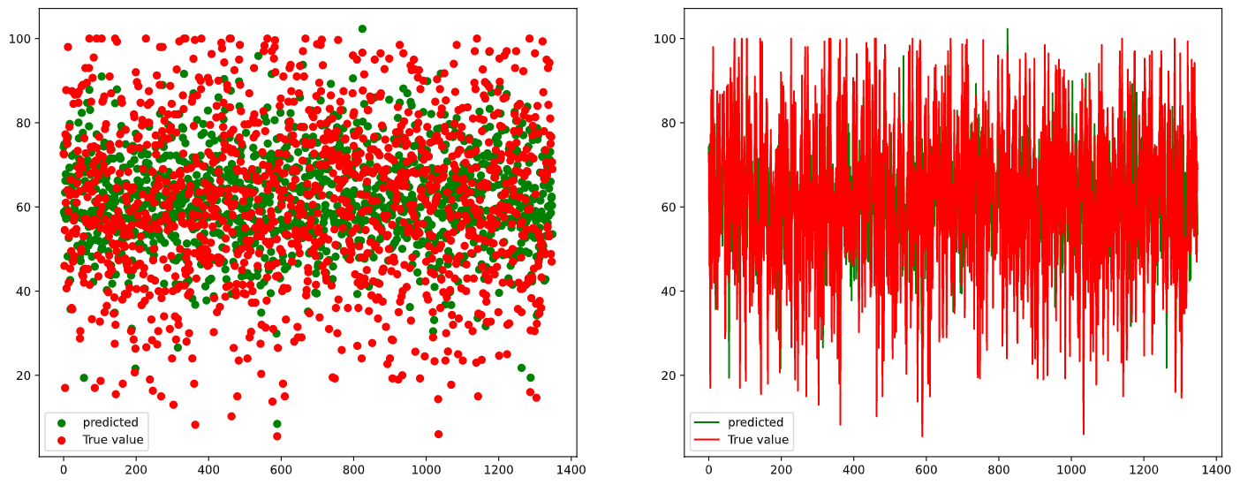
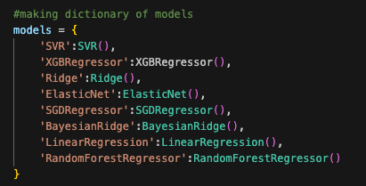
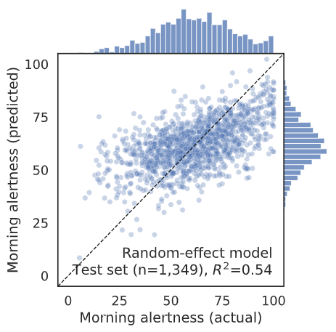
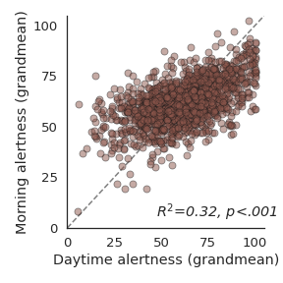
Model Analysis (Success Measure)
Performed Stand Scalar transformation on numerical attributes.
XGBRegressor performed well with less RMSE value.
Cross-validated performance of the gradient boosting algorithm. Predictions of the trait alertness are plotted against the ground-truth values. Each dot represents an individual’s predicted and actual trait alertness.
Notes:
Performed Standscalar transformation on numerical attributes
MinMaxScaler scales the data to a fixed range, typically between 0 and 1. On the other hand, StandardScaler rescales the data to have a mean of 0 and a standard deviation of 1. This results in a distribution with zero mean and unit variance. The choice between MinMaxScaler and StandardScaler depends on the data distribution, the nature of the analysis, and the algorithm being used.
Multi variate Linear regression
Models
'SVR':
'XGBRegressor
'Ridge
'ElasticNet':
'SGDRegressor':SGDRegressor(),
'BayesianRidge':BayesianRidge(),
'LinearRegression':LinearRegression(),
'RandomForestRegressor':RandomForestRegressor()
Cross-validated performance of the gradient boosting algorithm. Predictions of the trait alertness are plotted against the ground-truth values. Each dot represents an individual’s predicted and actual trait alertness.

Slide 30
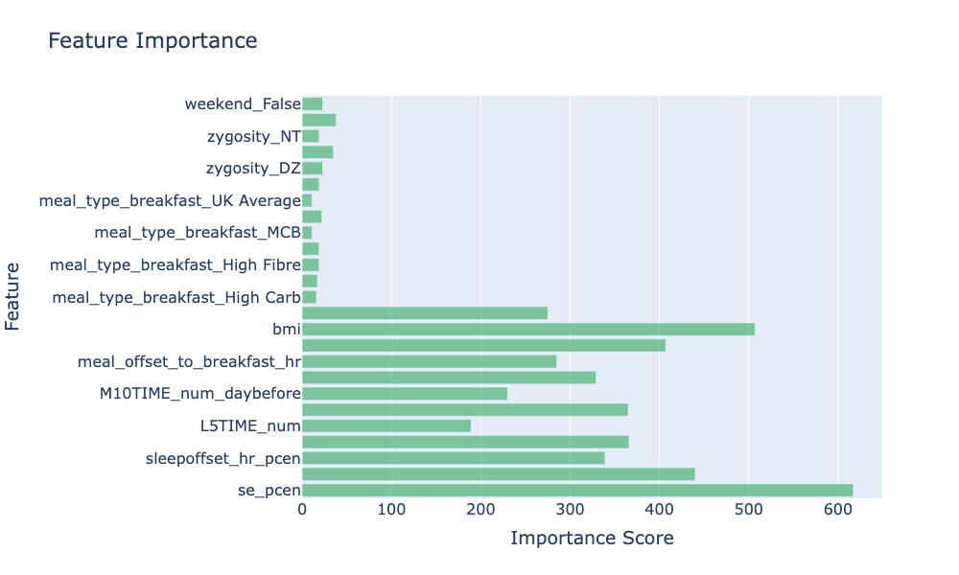
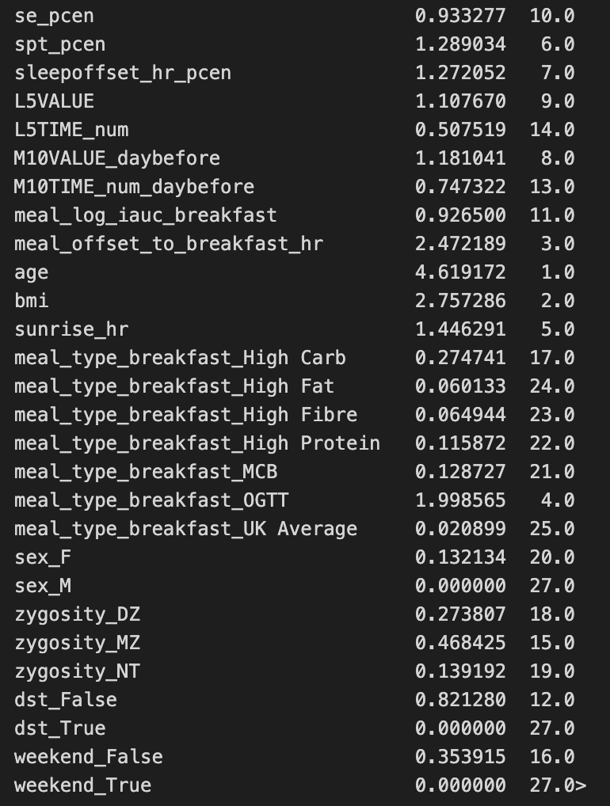
Model Analysis (Success Measure)
Notes:
You can see the feature ranking

Slide 31

Future Direction
Integration of advanced edge AI devices.
Using wearable devices for real-time monitoring of physiological data such as heart rate, oxygen levels, and sleep stages.
Combine wearable data with smartphone apps to provide instant feedback on how daily habits influence next0morning alertness.
Individuals can improve their daily alertness and overall well-being by keeping track of their daily habits.

Slide 32
Conclusion
Lifestyle factors such as sleep quality, physical activity, and dietary habits significantly influence morning alertness and daily productivity.
Individuals who wake up early have higher alertness levels despite the same amount of good sleep as those who wake up late. This finding supports the concept of sleep efficiency and circadian rhythm, emphasizing the importance of waking up early for optimal alertness.
Increased wakefulness after sleep onset leads to reduced alertness the following day.
The macronutrient composition of breakfast significantly affects alertness after sleep, with high-carbohydrate breakfast increasing alertness and high-protein breakfast decreasing alertness.
The impact of breakfast on alertness is not solely dependent on energy content or postprandial blood glucose levels, but also on the specific macronutrient composition.
Finding suggest that alertness is predominantly shaped by lifestyle choices rather than genetics.
Higher physical activity levels on the previous day (represented by higher M10 values) are associated with increased next-day morning alertness, while greater movement during the least active period (represented by higher L5 values) leads to lower alertness.
Notes:
Wakeup early → high alertness level, despite good sleep as those who wake up late. Sleep efficiency and circadian rhythm emphasizes the importance of waking up for optimal alertness.
Remaining wakefulness after sleeponset leads to low alertness following day.
The macronutrient composition of breakfast significantly affects alertness after sleep, with high-carbohydrate breakfast increasing alertness and high-protein breakfast decreasing alertness.
The impact of breakfast on alertness is not solely dependent on energy content or postprandial blood glucose levels, but also on the specific macronutrient composition.
Higher physical activity levels on the previous day are associated with increased next-day morning alertness, while greater movement during the least active period leads to lower alertness,

Slide 33
Thank You!! Have a Good Sleep !! Any Questions?

